Slide 1




Indian Government Data Analysis on Gram Panchayat development plan
kuntaharshinipatel@gmail.com
https://www.linkedin.com/in/kunta-harshini-751484314/
Statewise-district-wise-gpdp-data.csv
Dataset source url: www.data.gov.in

Slide 2
Dataset Overview
The dataset provides insights into the Gram Panchayat Development Plans (GPDP) across various states and districts in India. GPDP is a strategic framework designed to improve rural development by empowering Gram Panchayats (village-level administrative units) to plan and execute developmental activities.The dataset covers 36 states and multiple districts within each state, giving a comprehensive view of rural development efforts nationwide.Each state and district has unique codes for easy identification, ensuring organized data representation.By including the financial year column, the dataset allows tracking of GPDP progress and initiatives over time.The dataset may also provide data on planned actions, funding, or specific initiatives carried out under GPDP, enabling policymakers to assess development priorities.

Slide 3
Introduction
Dataset describes about state-district-wise GPDP data (GPDP:Gram Panchayat Development Plans).Thedataset include 2190 rows and 10 cloums.In this dataset each state is included with 5-6 districts and the actions of GPDP are given.The dataset include 36 states. The GPDP is a structured framework aimed at improving rural development by implementing various initiatives at the Gram Panchayat level.
1.stateCode : Unique code assigned to each state for identification.
2.stateName : Name of the state or union territory.
3.districtCode : Unique code assigned to each district for identification.
4.districtName : Name of the district within the respective state.

Slide 4
5.finYear : Financial year in the format 'YYYY-YYYY' (e.g., 2020-2021).
6.totalGP : Total number of Gram Panchayats (GP) in the respective district for the given financial year.
7.sabhaHeld : Number of sabha meetings conducted in the respective district for the given financial year.
8.gpdpApproved : Number of GPDP (Gram Panchayat Development Plans) approved in the respective district.
9.gpdpUpload : Number of GPDP plans uploaded online in the respective district.
10.date updated : The date when the data was last updated, ensuring the latest available information.

Slide 5
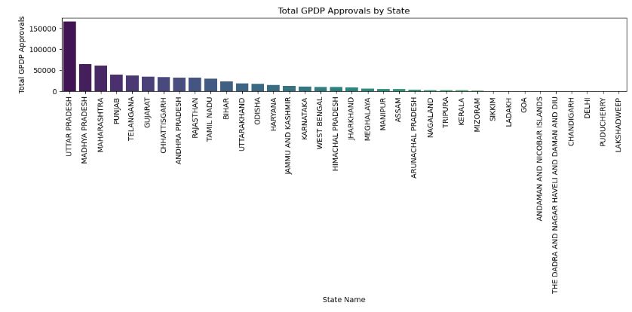
Data Visualization

Slide 6
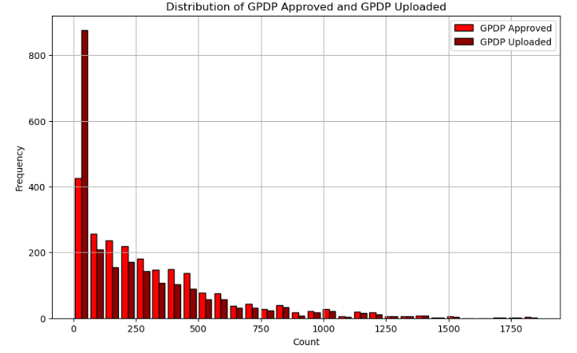

Slide 7
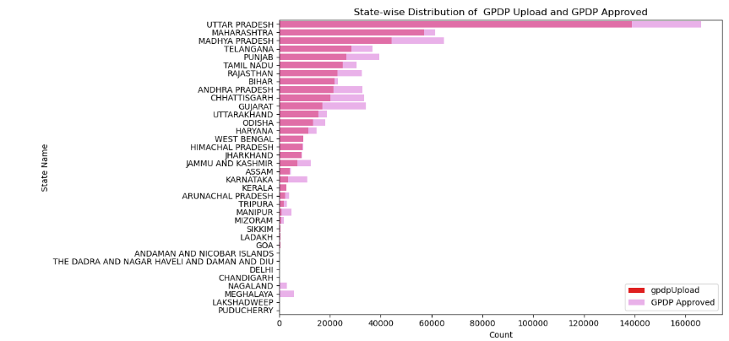
It gives the information about GPDP upload and GPDP Approved in state wise. Most of the states have high GPDP rates some states don’t have any GPDP rate.

Slide 8
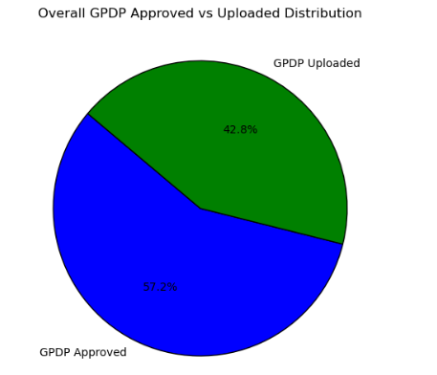
GPDP Approved rate is higher compare to GPDP Uploaded

Slide 9
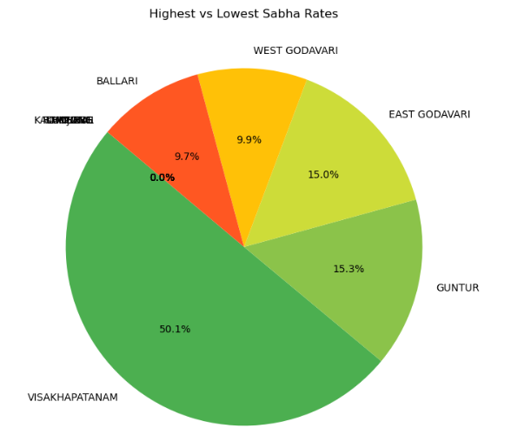
Vishakapatnam is having highest sabha rate.Most of the states don’t attend any sabha meetings.

Slide 10
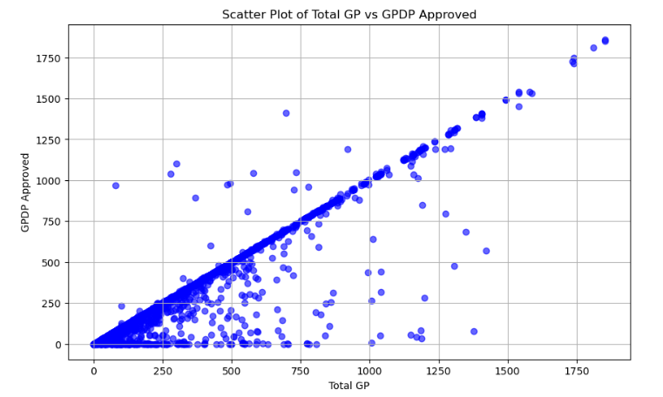
GPDP Approved is very closer to the applied Total Gp

Slide 11
Dataset Observations
The dataset contains 2,190 rows and 10 columns, representing state and district-wise GPDP (Gram Panchayat Development Plans) data.
No Missing Values: There are no null values in the dataset, ensuring data completeness.
Highest Approval District: Visakhapatnam in Andhra Pradesh has the highest GPDP approval rate.
Lowest Approval District: Udalguri in Assam recorded the lowest GPDP approval rate.
Highest GPDP State: Andhra Pradesh reported the highest total GPDP approved.
Lowest GPDP State: Lakshadweep had the lowest GPDP approval rate.
Districts with High Sabha Attendance: Visakhapatnam, Andhra Pradesh had the highest sabha attendance rate.
Districts with Low Sabha Attendance: Districts such as Ramgarh in Jharkhand and several in Manipur showed zero sabha attendance.
Total States Covered: The dataset includes data from 36 states/UTs.
States with Maximum Districts: Uttar Pradesh has the most districts, with 75 districts.
Total GPDP Distribution: Andhra Pradesh leads with the highest number of GPDP approvals.
GPDP Upload Performance: The district of Baksa in Assam showed an infinite GPDP upload rate due to zero approved plans.

Slide 12
Conclusion
This dataset analysis helps in developing of gram panchayat plans for each district-wise.we can easily findout the gpdp approved rates
and gpdp upload rates how many districts are active in participating sabha meetings.By analyzing all these things we can take several steps that helps in improving and developing each village facilities and districts and can provide a better way of living
Analyzing this dataset can reveal crucial insights that are highly valuable for policy-making, resource allocation, and rural development planning.By analyzing GPDP approvals, uploads, and sabhaHeld, you can identify:Active regions that are efficiently implementing development plans.Underperforming regions where GPDP actions are lagging, signaling the need for better support or intervention.

